Slide 1
VLAN Tagging

Slide 2
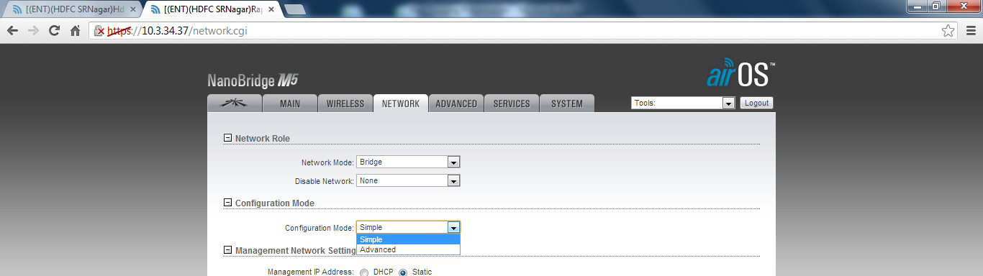
VLAN Tagging For Other City
Logging Customer end Radio(Don’t tag vlan at near end)
Go to Network tab and select configuration mode as “Advance” as shown below.

Slide 3
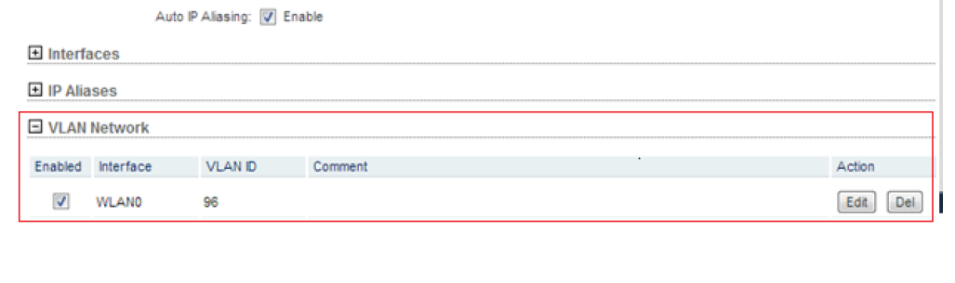
Go to the VLAN Network Tab & in that select WLAN0 Interface.
Put 96 VLAN in “VLAN ID” & write “Local” in comment & click on add.

Slide 4
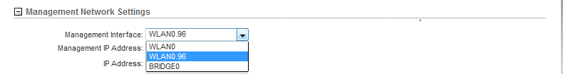
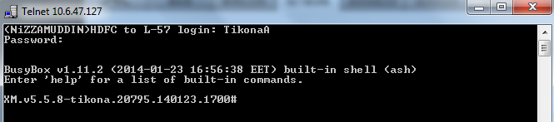

Now select Management Interface as “WLAN0.96”
IMP Step
Now Telnet Client end radio IP
Logging the radio with radio logging credential.
Put the command “vi /etc/persistent/rc.poststart” & press enter.

Slide 5
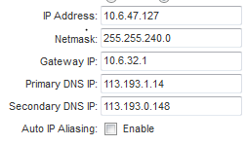
You will get the IP Add, Subnet mask & getway; Put this IP’s in Management N/W setting.
Auto IP Aliasing is always un-check.
Don’t touch to DNS .

Slide 6

Now Click on IP Aliases. & Made interface BRIDGE0
Put IP 1.1.1.3 & netmask 255.255.255.0 Put “Local” in comment box
Click on Add tab.
Now Check again
Management Interface should be WLAN0.96
ALL IP Should be properly configured.
Auto IP Aliasing should be Un-Check.
In IP Aliases interface should be BRIDGE0.
In VLAN N/w interface should be WLAN0
Now Click on Change at the bottom right of the page then click on Apply; If you are not confidant then click on TEST so that if your test fails then radio will come up in next 3 min; IF Test pass then click on APPLY.

Slide 7
Configure Client VLAN
We have configured Management VLAN in N/W; Now need to configured Client VLAN to make client up.

Slide 8
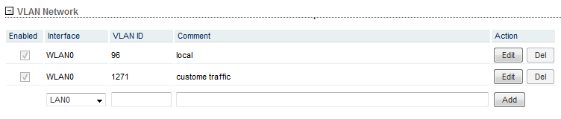
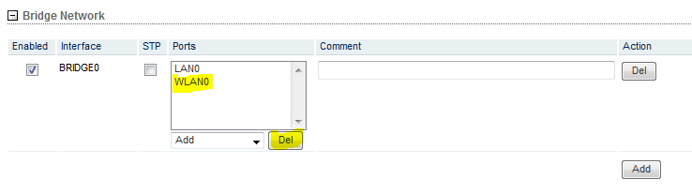
Click On VLAN Network & select interface WLAN0 then put Client VLAN ID; write “Client” in Comment then Click on Add.
Now Click on Bridge Network & Select on WLAN0 & Del it.
Now Click on ADD tab in Ports column & ADD “WLAN0.1271”
Now click on Change & Click APPLY.

Slide 9
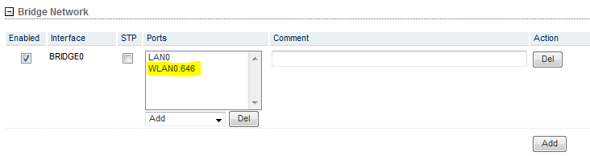

Slide 10
VLAN Tagging OF MUM City

Slide 11
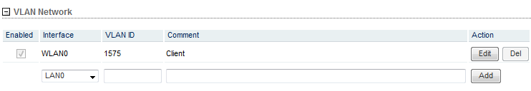
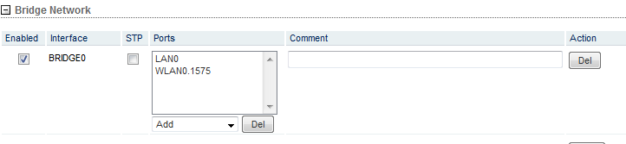
Directly Go to VLAN Network & Configured client VLAN

Slide 12
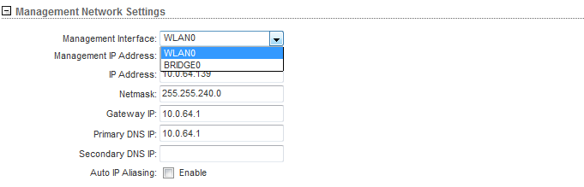
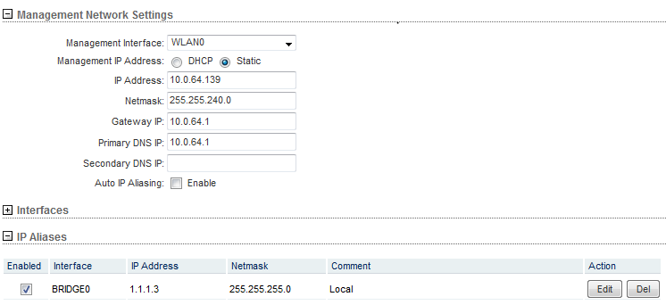
Select WLAN0 in management interface & PUT Local Logging IP’s

Slide 13
Now Check again
Management Interface should be WLAN0
ALL IP Should be properly configured.
Auto IP Aliasing should be Un-Check.
In IP Aliases interface should be BRIDGE0.
In VLAN N/w interface should be WLAN0
Now Click on Change at the bottom right of the page then click on Apply; If you are not confidant then click on TEST so that if your test fails then radio will come up in next 3 min; IF Test pass then click on APPLY.

Slide 14
Congrats You have Done Well

